Slide 1
Performance cycle in Q3:
#potential
#development
#growth
Prepared by Elsa Mendes
Date 19/07/2022

Slide 2
Agenda
❕ What
📑 Development plans
❔ Why
💡 Some ideas
📌 Where
🔗 Additional readings
🗓️ When
🤔 Q&A

Slide 3
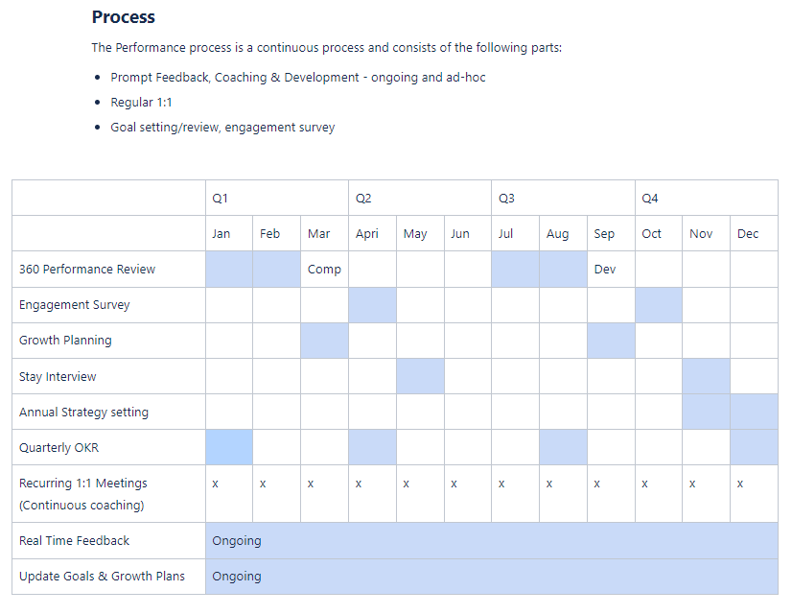
What’s a Performance cycle
Performance cycles, Performance reviews, Feedback cycle, Annual review, … - these are all common names used by different companies to represent the moment where we, teammates, are working together to help each other grow in our careers. At MOSTLY AI, formal performance reviews happen twice a year. In Q3 the focus is on the professional development plans to support your growth throughout the second half of the year (aka H2). This is a moment to go over your self review, your manager review, plan your goals and tie them to specific actions that will support your growth. You can read more about the process and its timeline here.

Slide 4
Why doing a Performance cycle
TL;DR: to support your growth! But remember, you are the owner of your own growth.
Now in more detail:
Align performance to goals and objectives
Provide a basis for promotion/transfer/termination (hopefully not!)
Get rid of the painful performance improvement plan process
Improve communication
Enhance effectiveness
Reduce turnover
Identify development opportunities

Slide 5
Where
iN rEaL lIfe and we use Leapsome to document all our reviews.
*this post is not sponsored by Leapsome

Slide 6
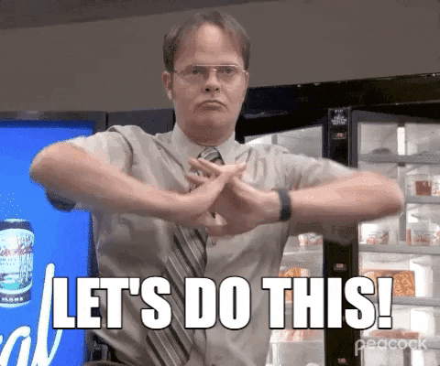
When

Slide 7
When
Date From/To | Steps of the process | Where
3 August 2022 - 29 August 2022 | #1 Retrospective and planning | Leapsome
3 August 2022 - 16 Sep 2022 | #2 Definition of development plan: session 1 | Hangouts, Slack, Zoom
3 August 2022 - 16 Sep 2022 | #2 Definition of development plan: session 2 | Hangouts, Slack, Zoom
16 Sep 2022 | #2 Recording of development plans | Leapsome
16 Sep 2022 - March 2023 | #3 Execution of development plan | iN rEaL lIfe

Slide 8
Step: #1 Retrospective and Planning
On 3rd August, a cycle will be launched on Leapsome and three players will be asked to review the performance of each teammate:
Teammate’s reflection 🤔 Some topics 👇🏾 | Peer’s reflection 🤔 Some topics 👇🏾 | Manager’s reflection 🤔 Some topics 👇🏾
Why did I miss a previous goal (if applicable)? What is my next career aspiration? What do I need to do in the next 6 months to be on track to achieve that career aspiration? What is stopping me from achieving it now? What type of: Education should I complete? Exposure should I pursue? Experience should I gain? | Highlights previous achievements, actions, behaviours and impacts. Peers are champions of our values and focus on: (…) Trust: Being responsible to each other and our customers Collaboration: Learning, creating, and evolving together Notes: Peers are nominated by teammates and subject to the managers’ approval Their reviews are assessed by the managers | Highlights and praises the previous achievements and goals. Understands what could have been done differently to achieve the missed goals (if any). Understands what helped on the goals that were achieved (if any). Learns from previous experiences B. and C. and puts the knowledge into practice.

Slide 9
Step: #2 Definition of the development plan
Managers and direct reports should engage to:
Session #1: Discuss the assessment of the previous months and trigger the conversation about the development plan for the future.
Session #2: Align and define the development plan for the upcoming 6 months. The ideal development plan should:
include a minimum of 1 SMART goal;
be aligned with MOSTLY AI’s OKRs and KPIs (read more about it here or go to Leapsome > Goals > Company & team goals).

Slide 10
Step: #2 Definition of the development plan
Remember:
As a part of our benefits, all MOSTLIES have a 1000€ / year budget to invest on their professional development.
The development plan should be recorded on Leapsome.
*this post in not sponsored by Leapsome.

Slide 11
Step: #3 Execution of the development plan
The development plan should be a recurring topic of conversation during your 1:1s meetings.
Look, they’re so easy to reach and connect. 🤝🏽
If adjustments are needed, these should be agreed by both parts and must be recorded on Leapsome.
*this post in not sponsored by Leapsome.

Slide 12
Development plans
Roles: Teammates and Managers have different roles and responsibilities when defining the development plan.
Teammate will wear one hat 🎩 | Manager will wear a different hat 👒
Reflects and plans for the next months, bearing in mind their next career aspiration(s). Should be proactive and prepare the plan independently and in advance. Uses this plan to set themselves up for success. | Coaches and supports the teammate defining and achieving the goals. The goals should be SMART. Ensure the teammate’s plan and goals are aligned with MOSTLY AI’s OKRs and KPIs. Uses this plan to set their direct reports up for success.

Slide 13
Development plans
SMART goals framework: you can read more about SMART goals here.
S | M | A | R | T
Specific | Measurable | Achievable | Relevant | Time-bound
❌ ”I want to be a better public speaker.”
✅ “I will attend a training course on Presenting to help me
improve my public speaking skills.
I will do it in October and November because in December
I will be busy with year-end tasks.”

Slide 14
Development plans
Approach - There can be different approaches to define a development plan:
Maximising existing strengths and competences.
Developing the areas that need to be improved.
Combining both a) and b)
There isn’t a magic formula, the best approach will depend on what needs to be achieved.
Tips - A good development plan should include:
Education - ex: read books, do online courses.
Exposure - ex: attend conferences, watch talks, shadow someone in a task.
Experience - ex: take on new responsibilities, lead a new project, start a new team initiative.

Slide 15
Some ideas
A good action plan should be specific, customised to the individual needs, challenging but also achievable. The plan should also work toward benefiting the whole MOSTLY AI team and be aligned with MOSTLY AI’s OKRs and KPIs.
Some of the most common actions are:
Mentoring others (usually junior teammates)
Learning from a mentor (usually a senior teammate or an industry expert)
Completing development courses
Earning professional certifications
Cross-training for another position within MOSTLY AI
Creating onboarding and learning programs for other Mostlies
Taking on more challenging tasks in their current role
Networking and team-building:
Attending meetups, professional conferences or seminars
Presenting meetings, workshops, talks, etc
Organising team-building events (ex. MOSTLY Mini Meetups; MOSTLY Lunch & Learn)

Slide 16
Additional readings
Performance
Elements of good feedback
How to do 1:1s with your team
How to prepare for a review
Performance calibration

Slide 17
Questions? Let’s do it!
Please join #mostly-learning on Slack to share your tips. Sharing is caring!

Slide 18
Thank you!

